Slide 1
Metals
Ch 7 and 8

Slide 2
Types and abundances of metals
Abundant metals
Average abundance in crust > 0.1 weight %
Fe, Al, Mg, Mn, Si, and Ti
Abundant enough that future availability will never be in doubt
Scarce metals
<<0.1 weight % in crust
Ferro-alloy metals e.g. Ni, Cr
Base metals e.g. Cu, Pb
Precious metals e.g. Au, Ag, Pt
Special metals e.g. Ga, Ge, REE

Slide 3
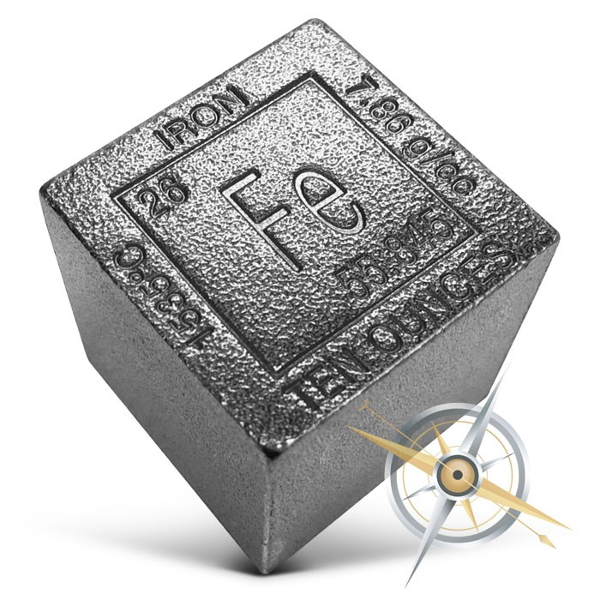
Iron: The backbone of industry
Iron and its alloys = 94% of all metal consumed
Abundant ores!
Ease of smelting!
Low cost!
Strong, durable, and easy to work!

Slide 4
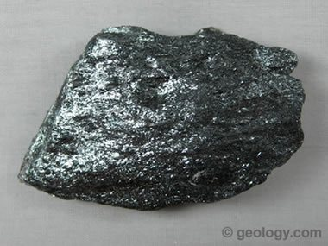
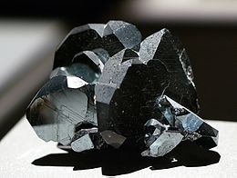
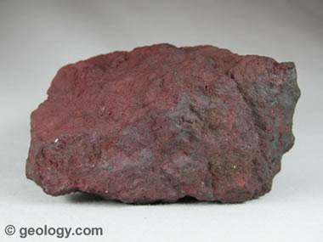
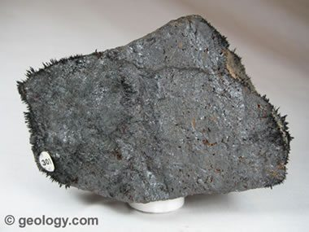
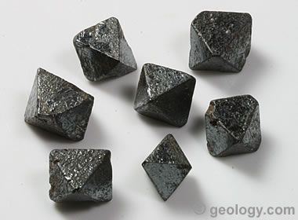
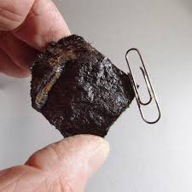
Iron ore minerals
OXIDES:
Hematite
Magnetite

Slide 5
Ferrous iron = Fe²⁺ Reducing conditions (no oxygen present)
More soluble
Ferric iron = Fe³⁺ Oxidizing conditions (oxygen present)
Insoluble

Slide 6
A common occurrence…
Great diversity of geologic processes which form Fe ores
Igneous, Sedimentary, and Metamorphic

Slide 7
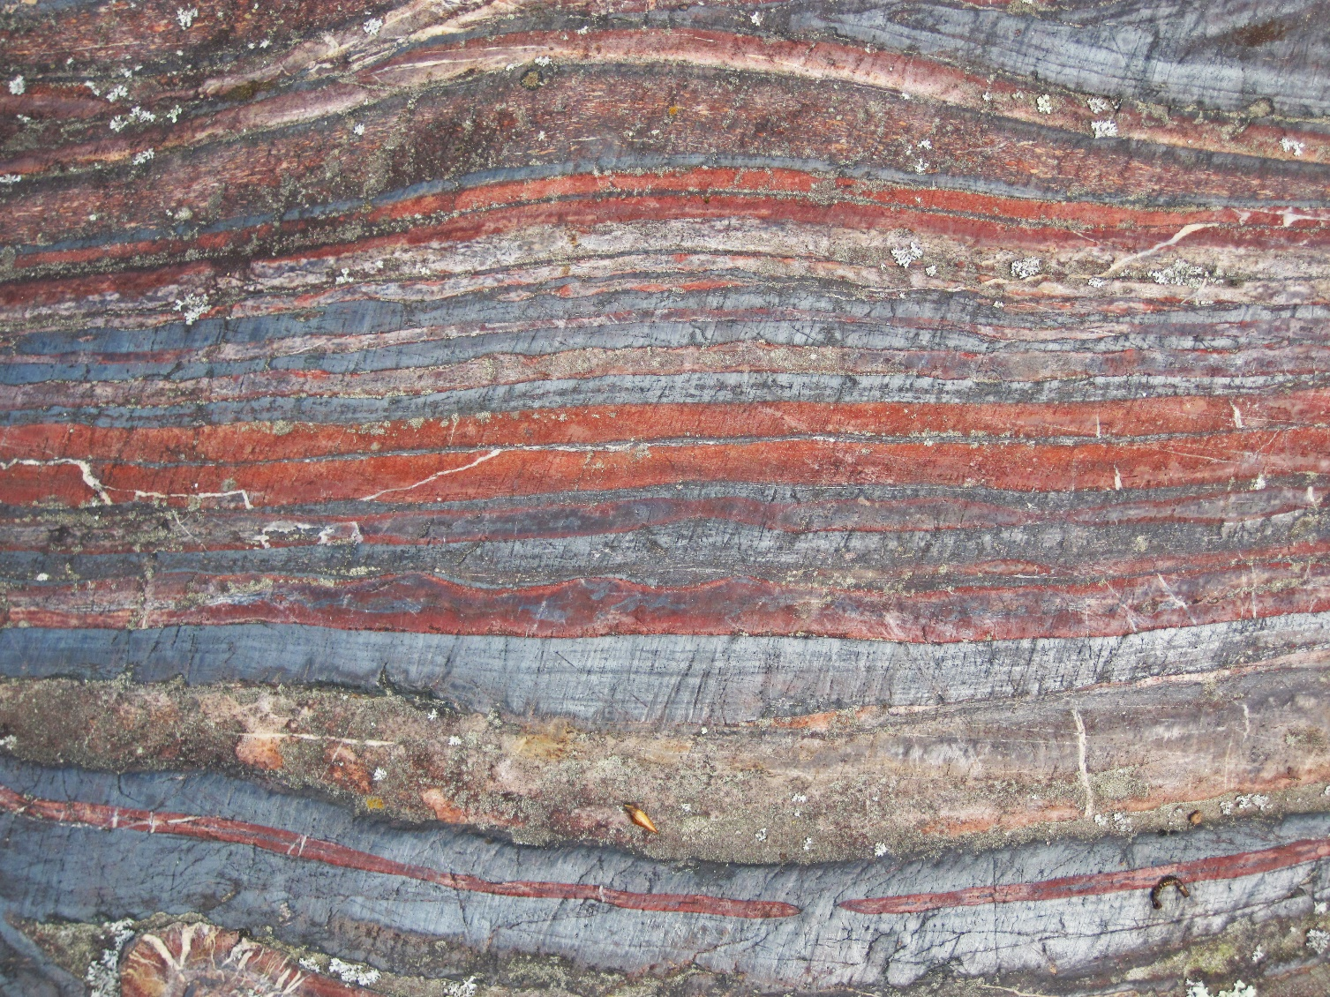
Banded Iron formations (BIFs)
Most important Fe deposits today
HUGE deposits in the great lakes area of the US!
Occur only in Precambrian rocks (i.e. rocks older than 520 Ma)

Slide 8
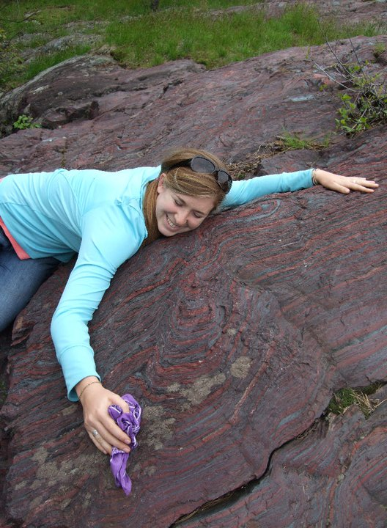
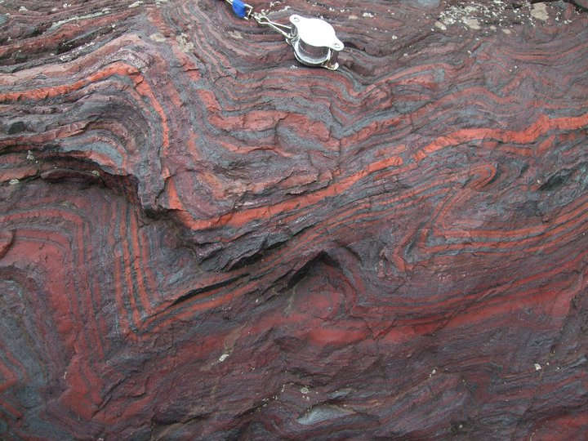
Alternating layers of fine grained magnetite+hematite and quartz

Slide 9
Banded Iron formations (BIFs)
Formed on the seafloor – chemical precipitates
All formed between 2.6 and 1.8 Ga
Banding of gray (hematite and Magnetite) and red (Quartz) layers

Slide 10
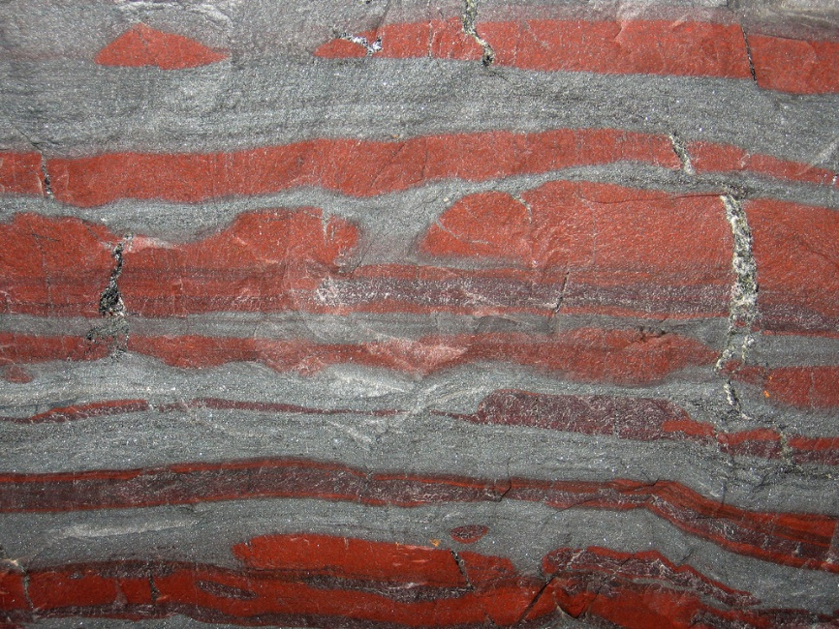
Mining enriched Fe-ores
BIF typically contain just 20-40% Iron
In some places, Intense chemical weathering has removed much of the silica/carbonate layers
Enriched residual ores are >55% Iron
Early mining of Iron – limited to these enriched ores

Slide 11
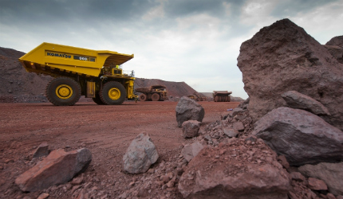
Great Precambrian Iron districts of the world:
Lake superior district, US
Labrador, Canada
Cerro Bolivar, Venezuela
Minas Gerais, Brazil
Hamersley, Australia
Krivoi Rog, Russia

Slide 12
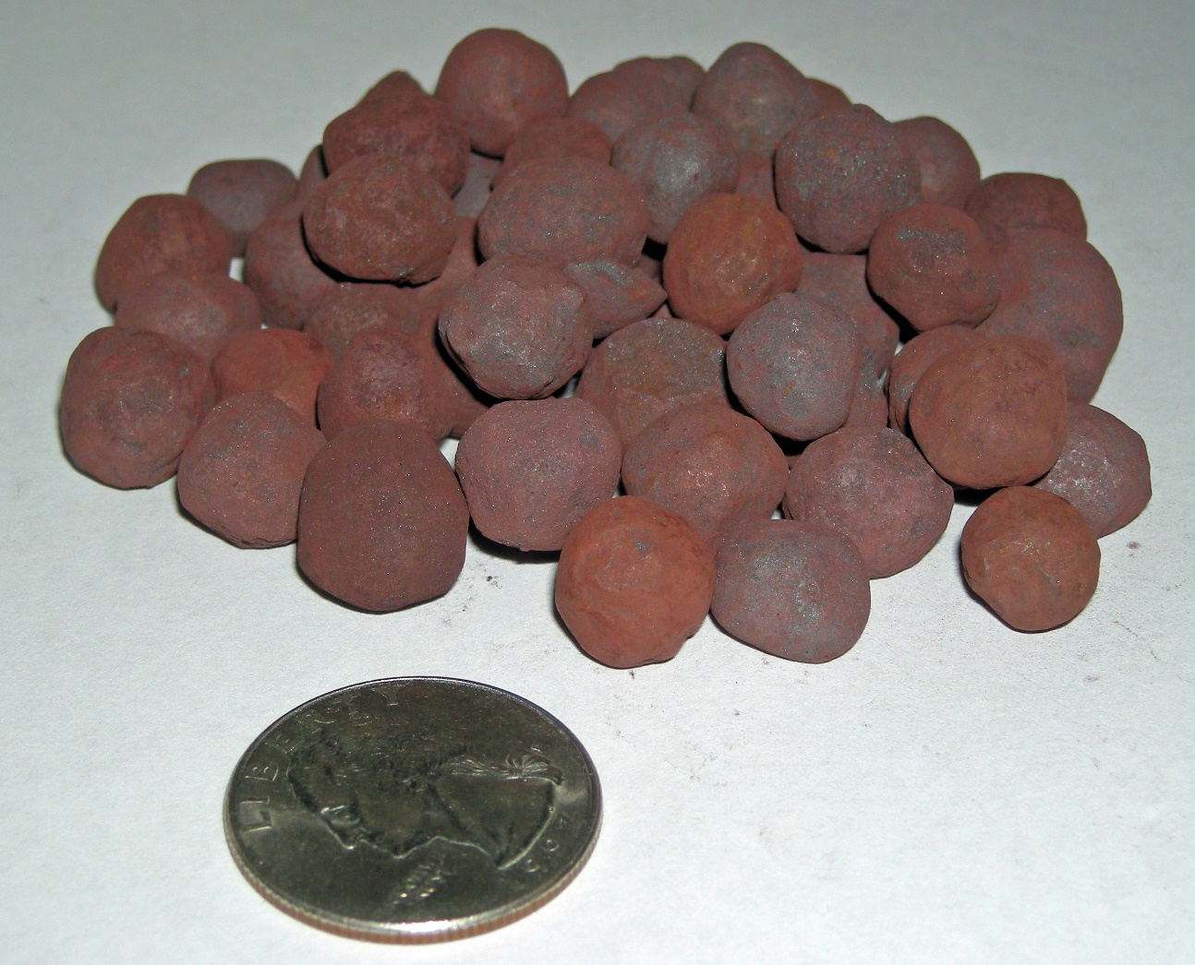
In Lake Superior District
These enriched portions of BIF ores were nearly all mined out by early 1900’s
How can we concentrate lower grade BIFs?
Grind the rock to powder
Separate Fe oxides from silicates
Mix with clay and form into pellets (~65% Fe)

Slide 13
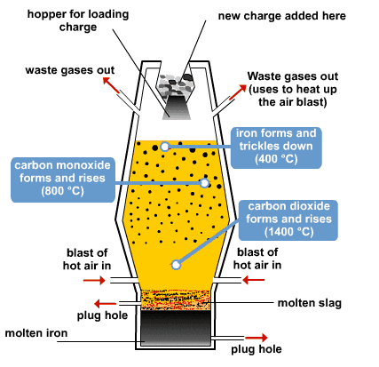
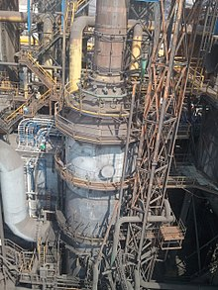
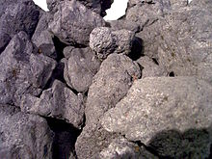
Blast furnaces smelting
Coke
Notes:
Origins ~1340 AD, evolved to present form
Cylindrical shaft lined with refractory material – bricks hard to melt
Coke is a fuel with few impurities and a high carbon content, usually made from coal. It is the solid carbonaceous material derived from destructive distillation of low-ash, low-sulphur bituminous coal. Cokes made from coal are grey, hard, and porous. The carbon monoxide produced by its combustion reduces iron oxide (hematite) in the production of the iron product.
1 Metric ton Iron = 1.6 mt of pellets + 0.7 mt of coke + 0.2 mt of limestone + 3.6 mt of hot air (1600°C/3000°F)
Chemical reactions → coke combusts to form CO
CO reduces Fe-oxides to Fe metal (and itself is oxidized to CO2)

Slide 14
History of American steel industry
During IR, American settlers mined small iron deposits in the Appalachians
In 1845 – the Lake Superior BIFs were discovered
Iron production shifted from Europe to the US – US dominated world Fe production from ~1900-1970
BIFs
Coal
Limestone

Slide 15
History of American steel industry
Production declined in Europe (and Japan) due to WWI, Great Depression, and WWII
US industry remained intact! Lion’s share of the world market ~1950s (47%)
But then… Europe and Japan rebuilt… with upgrades
Japan and China had cheap ocean shipping access to HUGE and very low-cost Fe deposits in Australia
Newer plants, lower operating costs
In 2008, US had just 7% of world Fe market
~50% of steel mills and furnaces have shut down since the 70’s
~60% decrease in jobs in this industry (20,000 to 7,500)
Notes:
Newer plants, lower operating costs
~50% of steel mills and furnaces have shut down since the 70’s
~60% decrease in jobs in this industry (20,000 to 7,500)

Slide 16
Aluminum
2nd most abundant metal (after Si)
BUT very difficult to free from most mineral forms
Only been mined for last 125 years
2nd most widely used metal (after Iron)

Slide 17
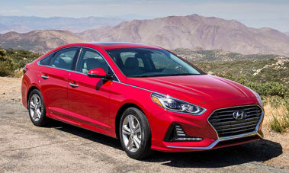
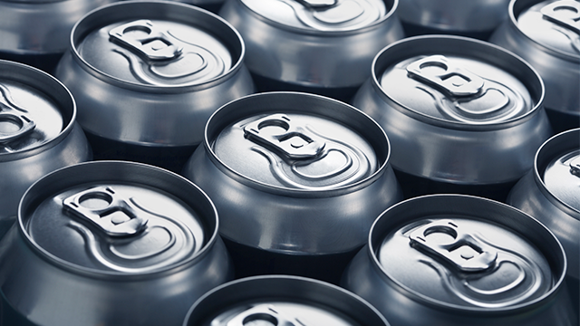
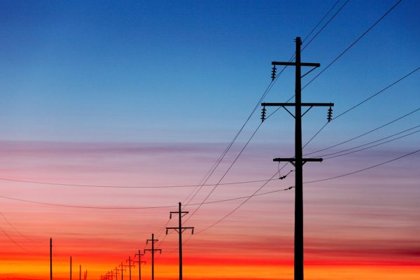
Aluminum use today
US uses the most aluminum (44 lbs/person/yr)
Transportation (38%)
Packaging (22%)
Building materials (16%)
Electrical (7%)
Other consumer goods (7%)
~150 lbs/car
>100 billion cans made in US each year
High strength to weight ratio

Slide 18
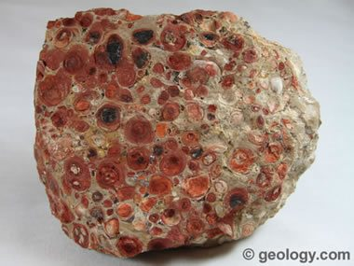
Al ore: Bauxite (material composed of Al hydroxides)
Formed in Laterite soils!
Subtropical to tropical climates
Abundant rainfall
Aluminous parent rocks (feldspars)
Sweet spot of topographic relief
High enough that there is drainage
Low enough that mechanical erosion of soil is slow relative to chemical leaching

Slide 19
Chemical weathering in lateritic conditions
Least soluble components:
SiO₂
Al₂O₃
Fe₂O₃
More soluble Na⁺, K⁺, Mg⁺, and Ca²⁺ is removed in solution
Decaying organic matter makes groundwater slightly acidic – dissolves much of the clays, silica and Fe minerals
Leaves Al-hydroxides (and some Fe-hydroxides) behind

Slide 20
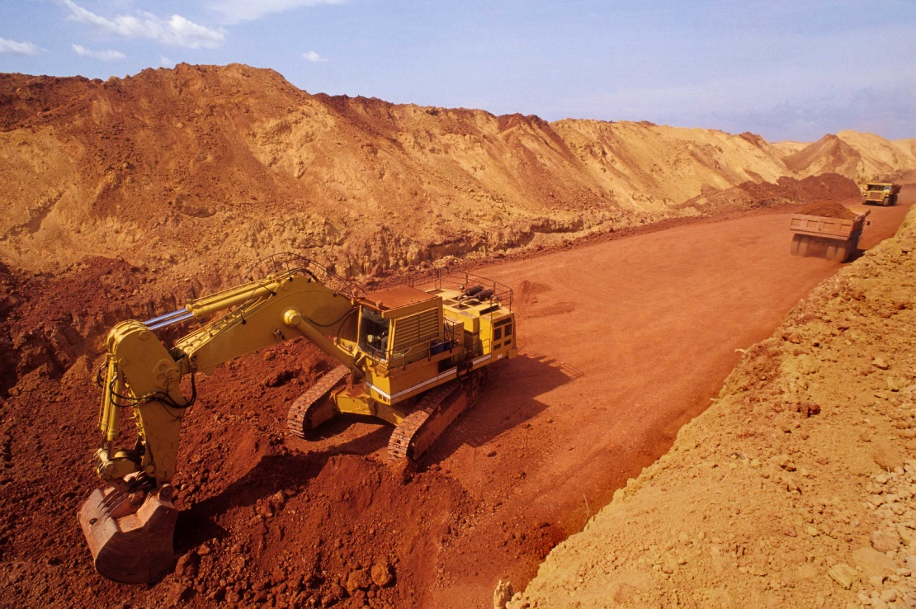
Aluminum production
Easy to mine the ore (soft, forms at the surface)
Processing that ore is VERY energy intensive
Bauxite mines are generally in tropical regions
→ often in countries where energy is not cheap
→ far from biggest markets of aluminum products
So the Bauxite ore is washed, dried and shipped to other countries like Norway, Canada, and the US

Slide 21
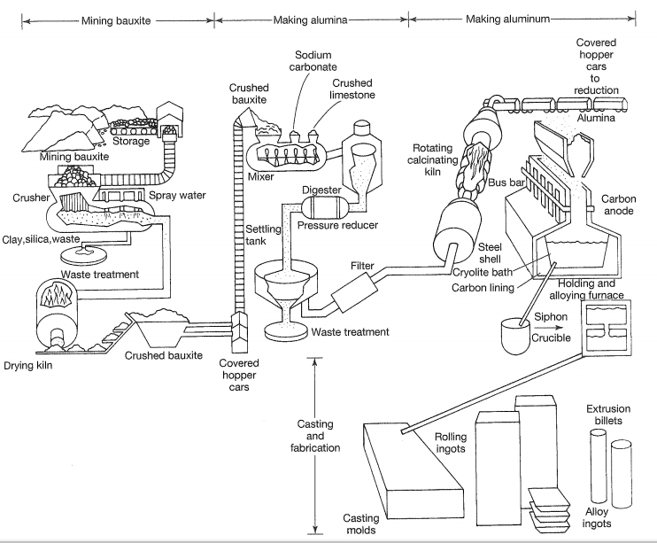
Notes:
mined, crushed, washed, dried and shipped
Make ore into alumina (Al2O3)
Then put alumina into molten cryolite (Na3AlF6) bath – this is both an electrolyte and solvent – reduces alumina to aluminum metal
This is high energy because temperature has to be maintained at 950°C, voltages must remain at 1000 volts, and electric currents at 150,000 amperes

Slide 22
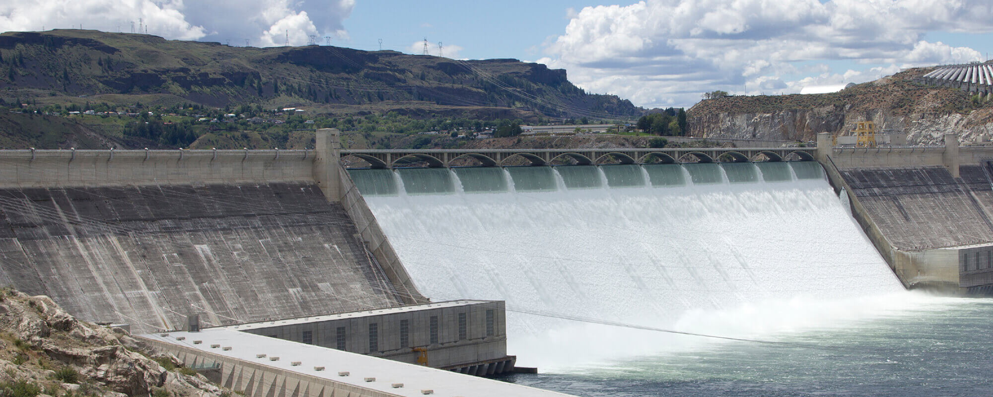
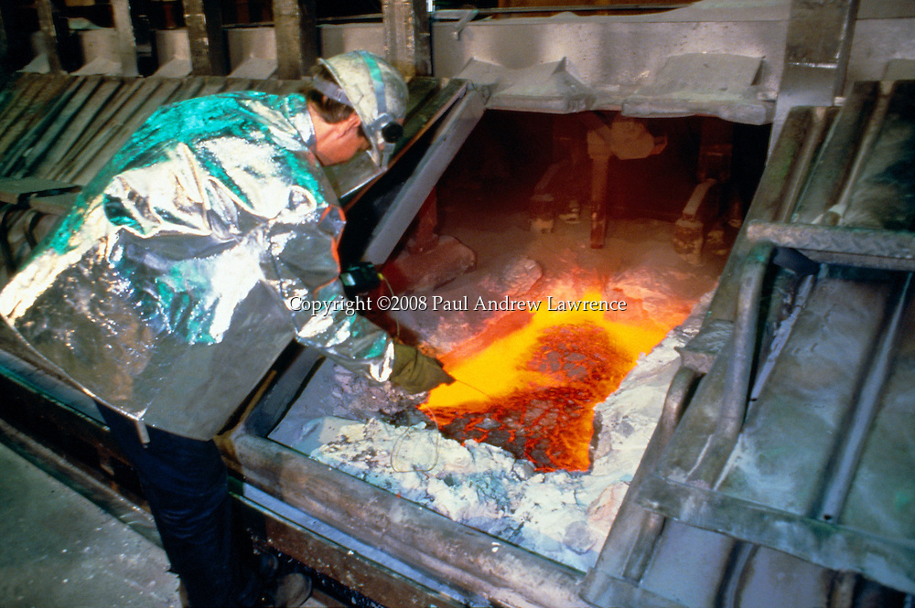
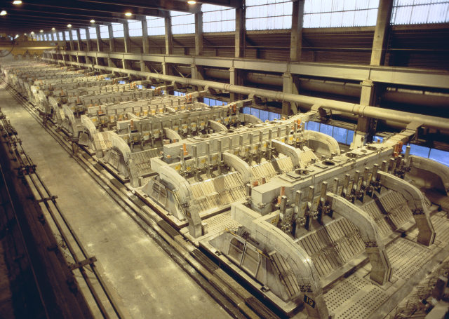
Notes:
Most Al smelting powered by hydrothermal plants. One coal fired plant in Aus, and they are building a geothermal energy plant in Iceland

Slide 23
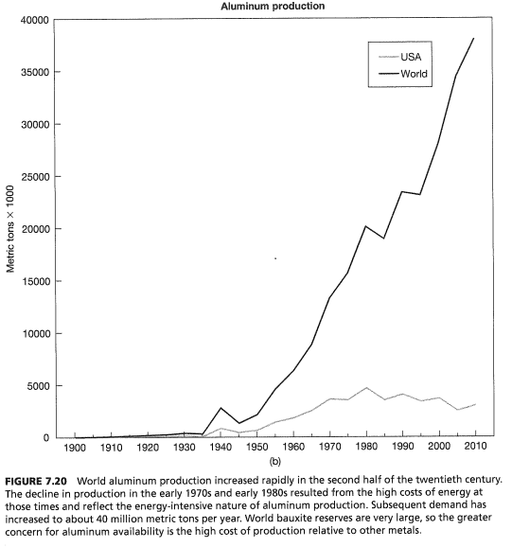
History of Al industry in US
Growth coincided with development of major power networks and building of major hydroelectric facilities
Leveled off after 1973 oil embargo when energy costs rose

Slide 24
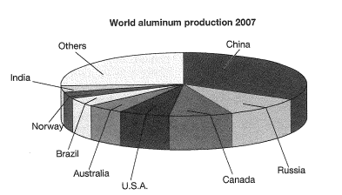

Slide 25
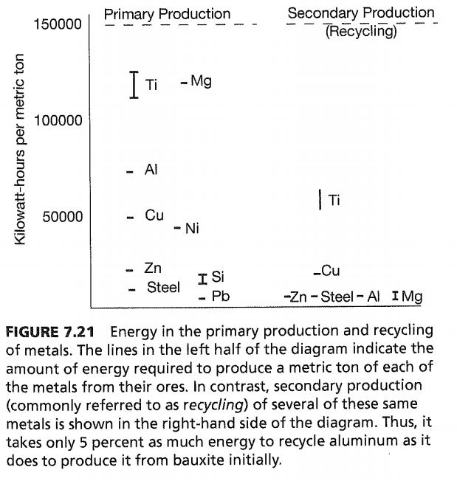
Energy use
Much higher energy than other common metals
MUCH less energy needed to recycle aluminum, than for primary production
Notes:
And this is for bauxite – the easiest Al bearing material to smelt
Importance of recycling – energy saving by 95%

Slide 26
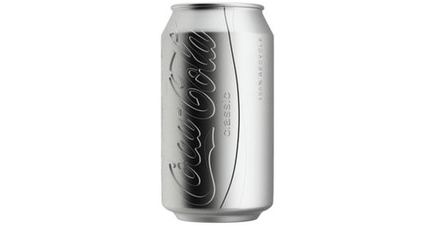
Japan example
Gasoline
Notes:
Japan – 1985 – closed primary Al production
100% Import Al scrap metal – this is awesome – its essentially like importing energy – as other countries put in the energy to produce that aluminum initially

Slide 27
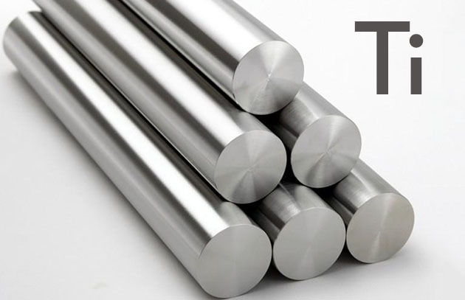

Titanium
Only been used on large scale for 50 yrs
Alloys – high strength to weight ratio, melting point, and corrosion resistance
White titanium oxide pigment
White, opaque, permanence of color, low toxicity
Principal pigment in paint, paper, plastic, rubbers and more
Notes:
Before that – white Pb oxide was used

Slide 28
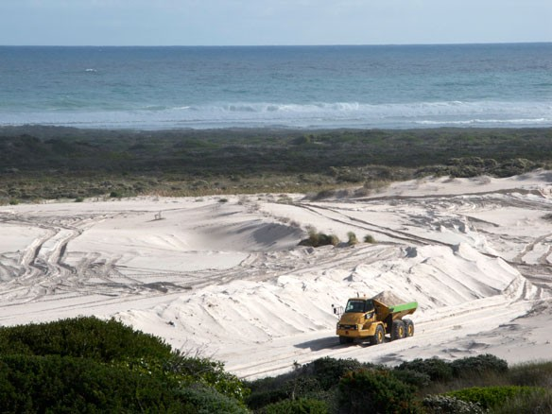
Ti Ores
Mafic minerals like Magnetite and ilmenite (layered mafic intrusions)
Heavy Ti bearing minerals (illmenite and rutile) are also formed in small quantities in many igneous and metamorphic rocks, which when reduced to a sediment, can be separated by density (placer deposits)

Slide 29
Processing of Ti
Mining is pretty low impact (especially beach placer deposits)
However processing produces a large amount of toxic sulfate and sulfuric acid waste
Used to be dumped into streams and oceans → Now we deal with it in acid neutralization plants
We are still dealing with run off from old plants…

Slide 30
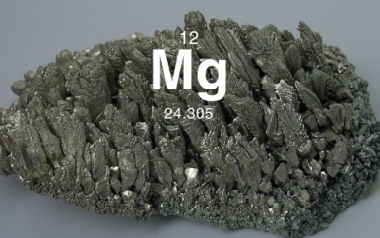
Mg
USES:
Alloys, cement, rubber
ORES:
Seawater!
Dolomite
Notes:
Draw illustration on Pg 260

Slide 31
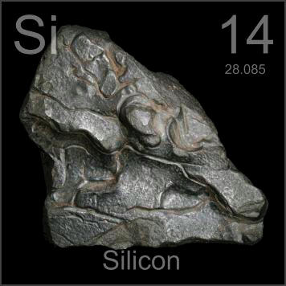
Si
USES:
Photovoltaic cells
Resins, lubricants, rubbers, and much more
ORES:
Molten quartz
VERY high energy

Slide 32
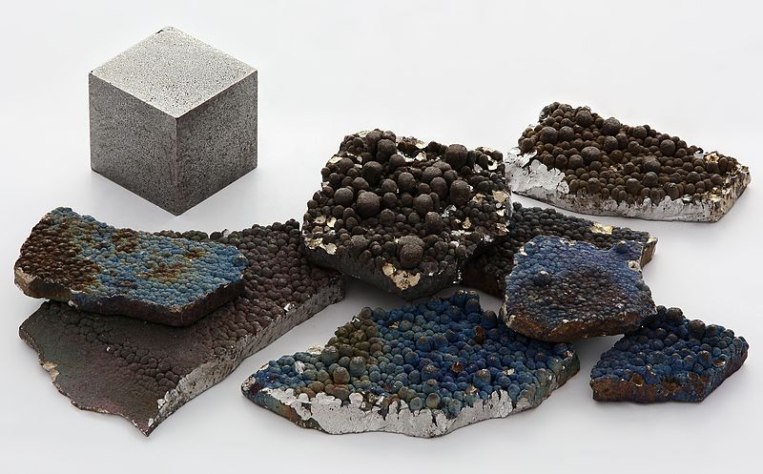
Manganese
USES:
steel production
Scavenges impurities from steel!
ORES:
Chemical precipitates (hydrothermal vents – VMS deposits)
Notes:
Also used in water purification (K permanganate) and dry cell betteries

